Slide 1
CHIRURGIA BARIATRICA
E
IPERTENSIONE PORTALE: BRIDGE PER TRAPIANTO DI FEGATO
Amanda belluzzi,MD
U.O.C. chirurgia generale, Ospedale S. Maria della Misericordia, Rovigo

Slide 2

CHIRURGIA BARIATRICA E IPERTENSIONE PORTALE:
BRIDGE PER TRAPIANTO DI FEGATO
KEY POINTS
Obesity, organ failure, end-stage liver disease and transplantation
Portal Hypertension: definition and clinical significance in MBS
MBS and Liver Transplant: where are we now?

Slide 3
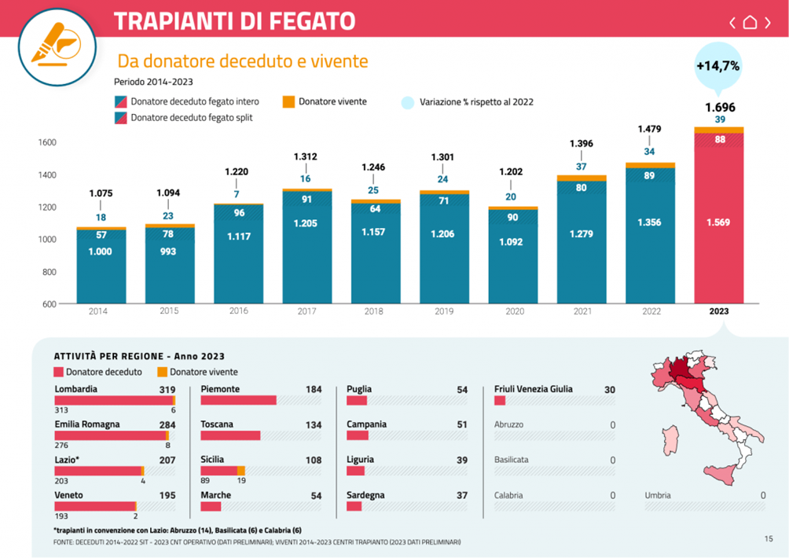
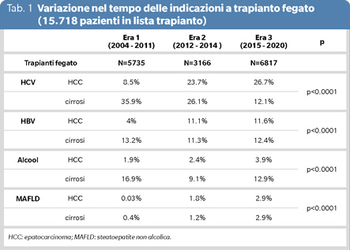
CHIRURGIA BARIATRICA E IPERTENSIONE PORTALE:
BRIDGE PER TRAPIANTO DI FEGATO
Obesity, organ failure,end-stage liver disease and transplantation

Slide 4
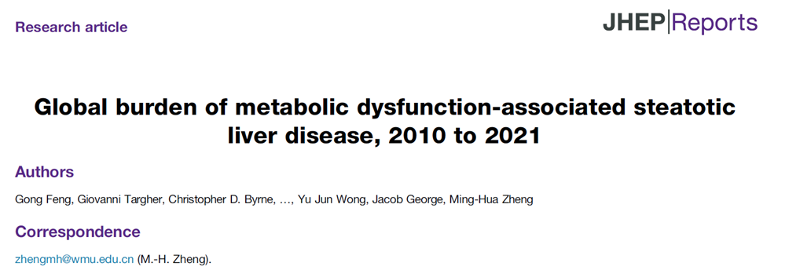
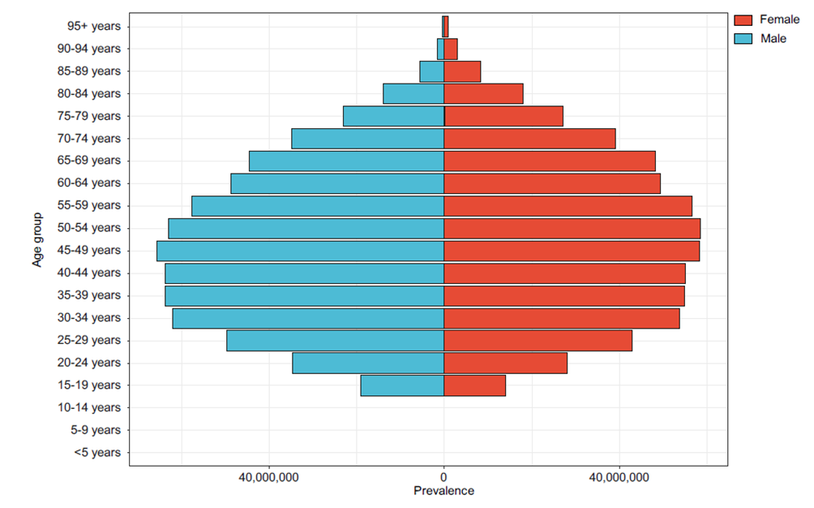
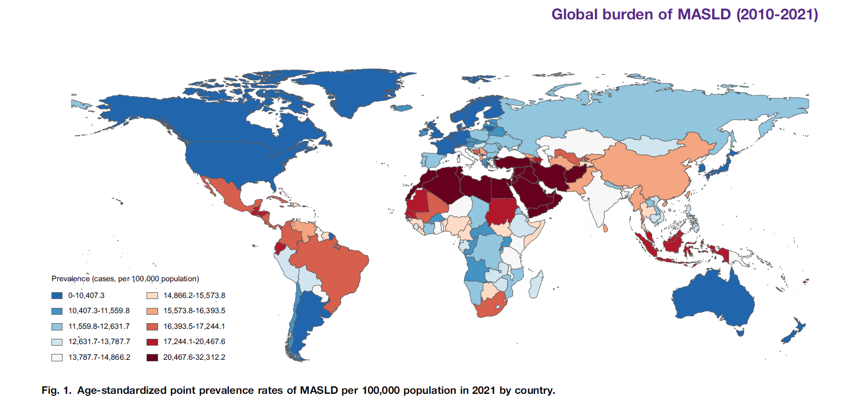
CHIRURGIA BARIATRICA E IPERTENSIONE PORTALE:
BRIDGE PER TRAPIANTO DI FEGATO
Obesity, organ failure, end-stage liver disease and transplantation
2024
Feng G et alGlobal burden of metabolic dysfunction-associated steatotic liver disease, 2010 to 2021. JHEP Rep. 2024 Nov 14;7(3):101271.

Slide 5
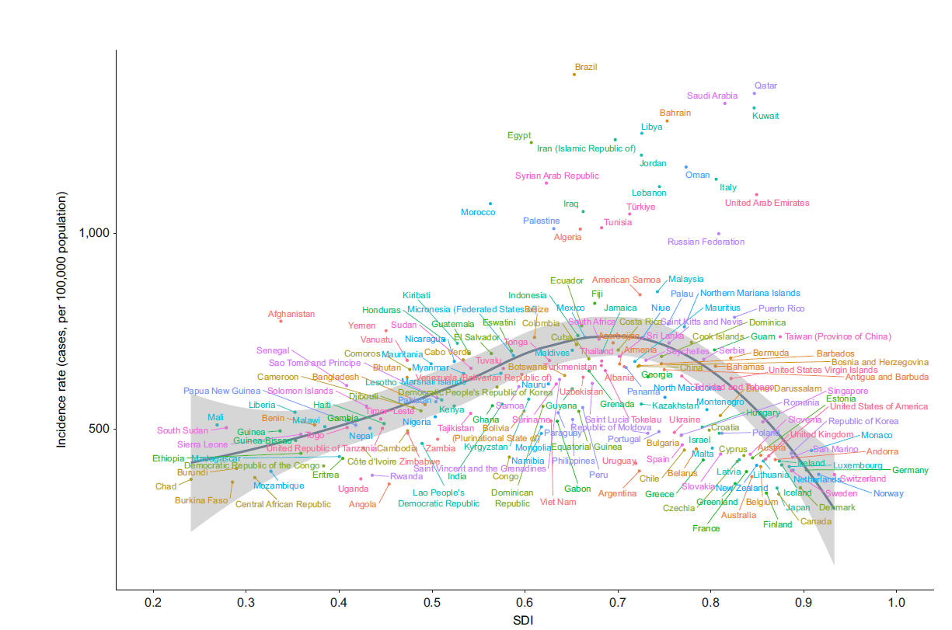
CHIRURGIA BARIATRICA E IPERTENSIONE PORTALE:
BRIDGE PER TRAPIANTO DI FEGATO
Obesity, organ failure, end-stage liver disease and transplantation
2024
Feng G et alGlobal burden of metabolic dysfunction-associated steatotic liver disease, 2010 to 2021. JHEP Rep. 2024 Nov 14;7(3):101271.

Slide 6
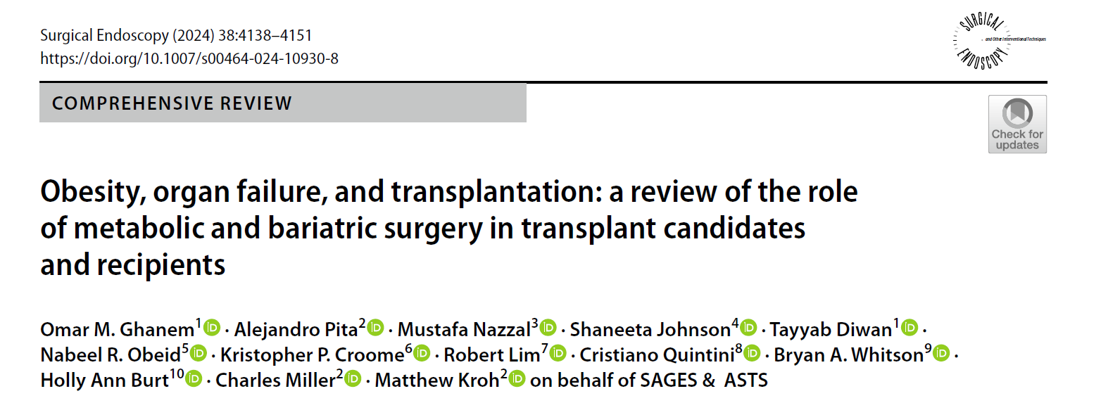
CHIRURGIA BARIATRICA E IPERTENSIONE PORTALE:
BRIDGE PER TRAPIANTO DI FEGATO
Obesity, organ failure,end-stage liver disease and transplantation
2024
Ghanem OM, Pita A, Nazzal M, Johnson S, Diwan T, Obeid NR, Croome KP, Lim R, Quintini C, Whitson BA, Burt HA, Miller C, Kroh M; SAGES & ASTS. Obesity, organ failure, and transplantation: a review of the role of metabolic and bariatric surgery in transplant candidates and recipients. Surg Endosc. 2024 Aug;38(8):4138-4151.

Slide 7
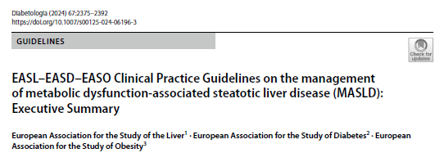
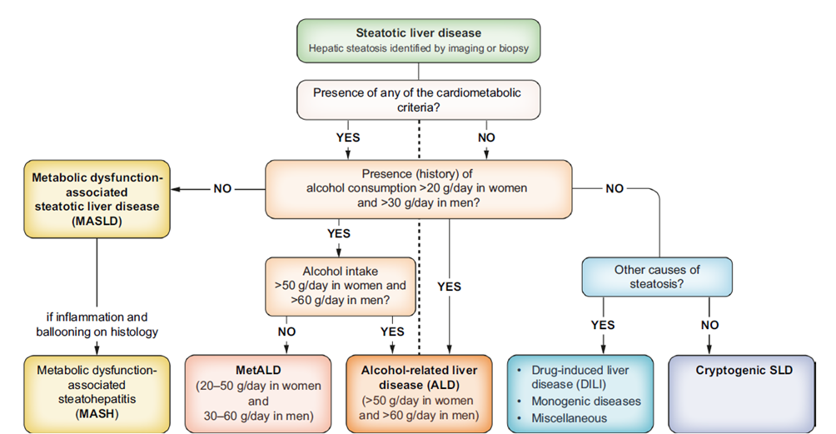
CHIRURGIA BARIATRICA E IPERTENSIONE PORTALE:
BRIDGE PER TRAPIANTO DI FEGATO
Obesity, organ failure,end-stage liver disease and transplantation
2024
European Association for the Study of the Liver; European Association for the Study of Diabetes; European Association for the Study of Obesity. EASL-EASD-EASO Clinical Practice Guidelines on the management of metabolic dysfunction-associated steatotic liver disease (MASLD): Executive Summary. Diabetologia. 2024 Nov;67(11):2375-2392.

Slide 8
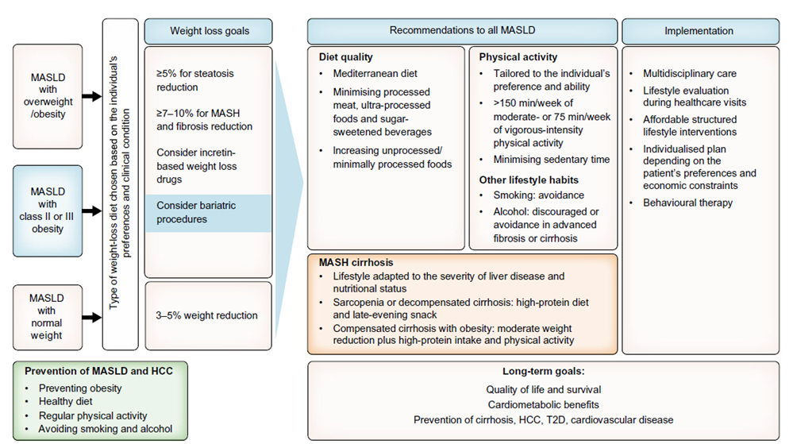
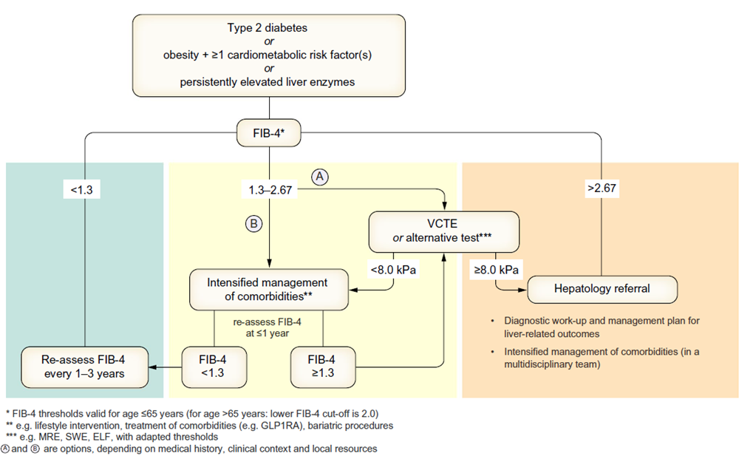
CHIRURGIA BARIATRICA E IPERTENSIONE PORTALE:
BRIDGE PER TRAPIANTO DI FEGATO
Obesity, organ failure,end-stage liver disease and transplantation
2024
European Association for the Study of the Liver; European Association for the Study of Diabetes; European Association for the Study of Obesity. EASL-EASD-EASO Clinical Practice Guidelines on the management of metabolic dysfunction-associated steatotic liver disease (MASLD): Executive Summary. Diabetologia. 2024 Nov;67(11):2375-2392.

Slide 9
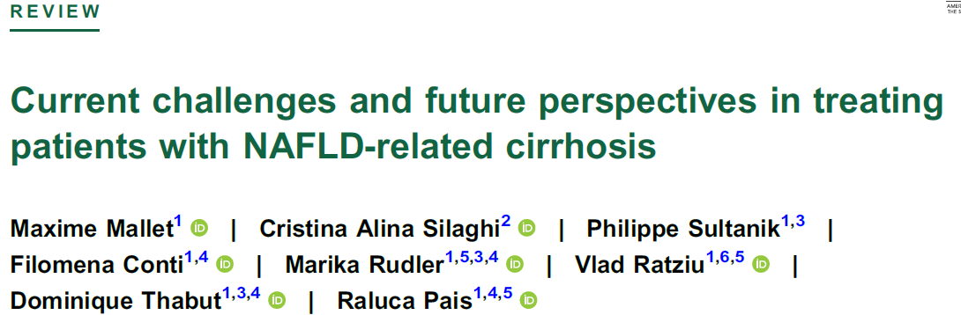
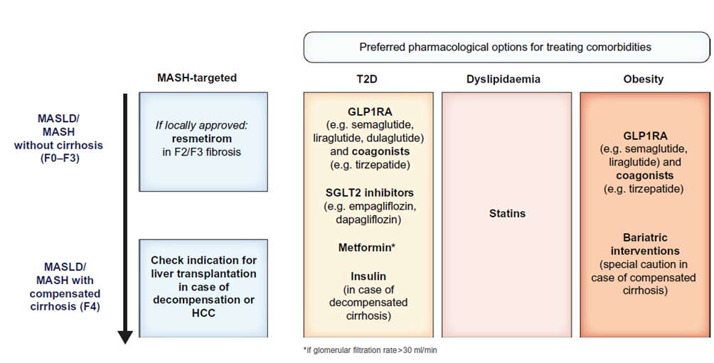
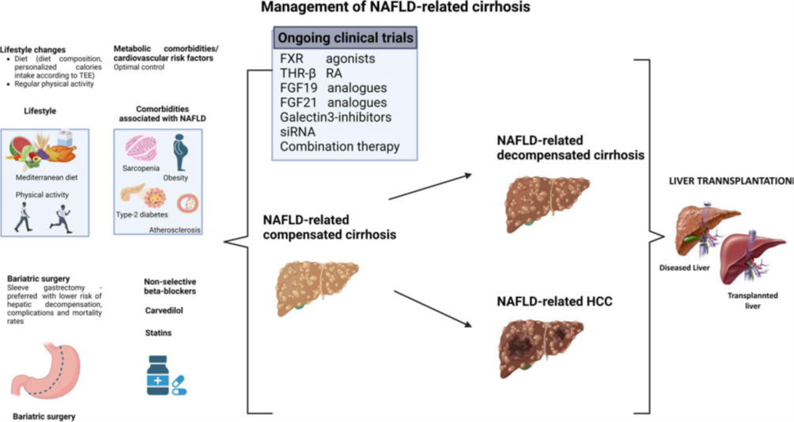
CHIRURGIA BARIATRICA E IPERTENSIONE PORTALE:
BRIDGE PER TRAPIANTO DI FEGATO
Obesity, organ failure,end-stage liver disease and transplantation
2024
2024
European Association for the Study of the Liver; European Association for the Study of Diabetes; European Association for the Study of Obesity. EASL-EASD-EASO Clinical Practice Guidelines on the management of metabolic dysfunction-associated steatotic liver disease (MASLD): Executive Summary. Diabetologia. 2024 Nov;67(11):2375-2392.
Mallet M, Silaghi CA, Sultanik P, Conti F, Rudler M, Ratziu V, Thabut D, Pais R. Current challenges and future perspectives in treating patients with NAFLD-related cirrhosis. Hepatology. 2024 Nov 1;80(5):1270-1290.

Slide 10
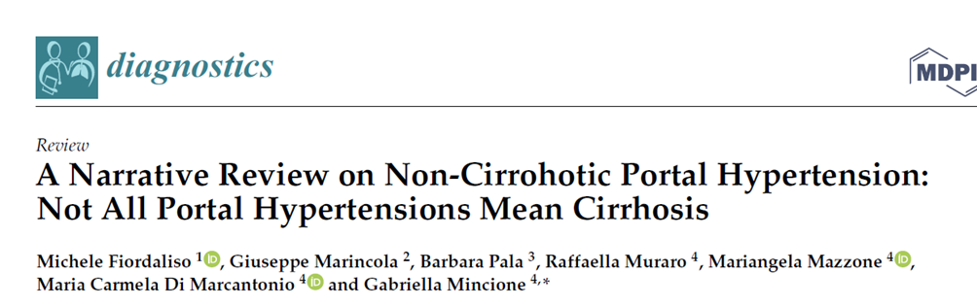
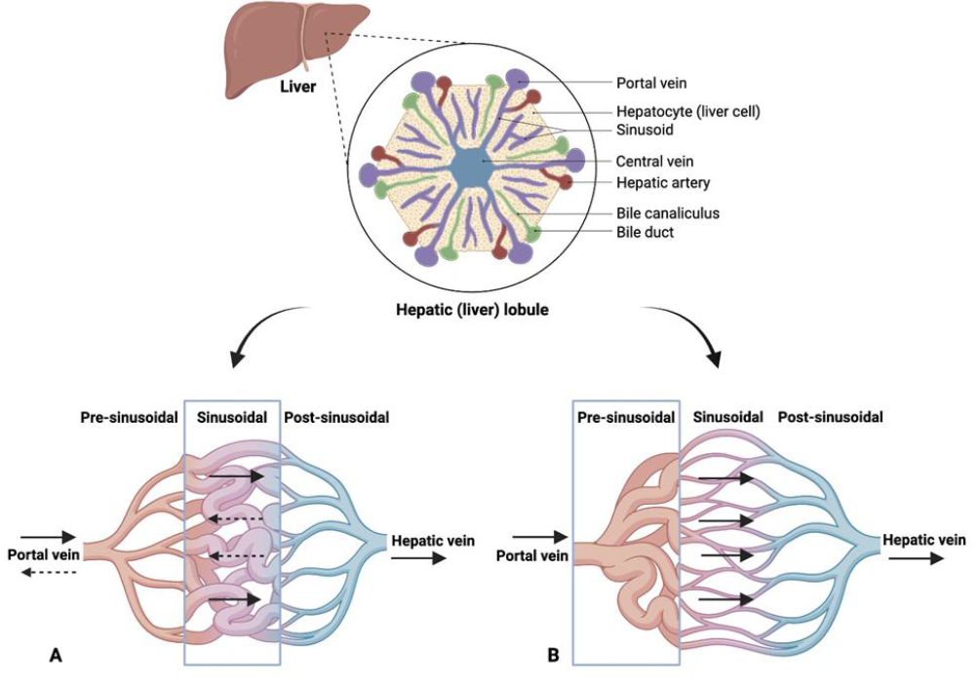
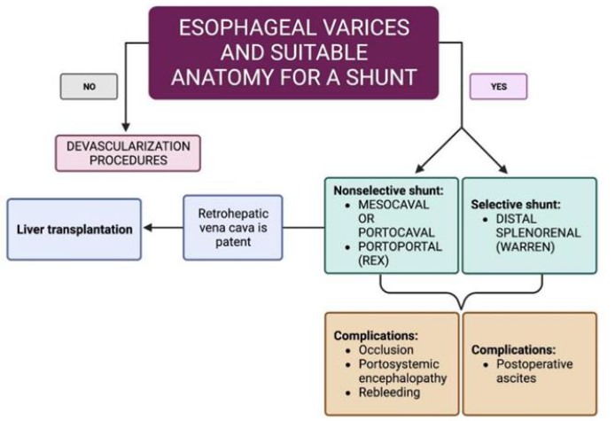
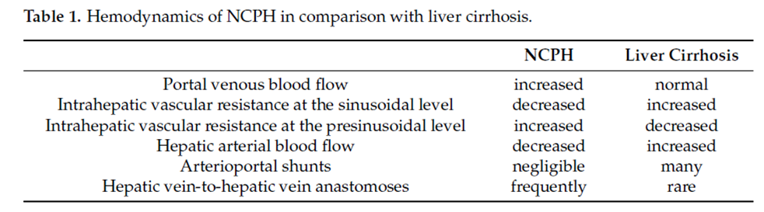
CHIRURGIA BARIATRICA E IPERTENSIONE PORTALE:
BRIDGE PER TRAPIANTO DI FEGATO
Portal Hypertension: definition and clinical significance in MBS
2023
Liver cirrhosis (A): increase in resistance at the sinusoidal level and a hepatofugal flow is evident
Non-Cirrhotic Portal Hypertension (NCPH) (B): the resistances increase at the presinusoidal level
Fiordaliso M, Marincola G, Pala B, Muraro R, Mazzone M, Di Marcantonio MC, Mincione G. A Narrative Review on Non-Cirrohotic Portal Hypertension: Not All Portal Hypertensions Mean Cirrhosis. Diagnostics (Basel). 2023 Oct 20;13(20):3263.

Slide 11

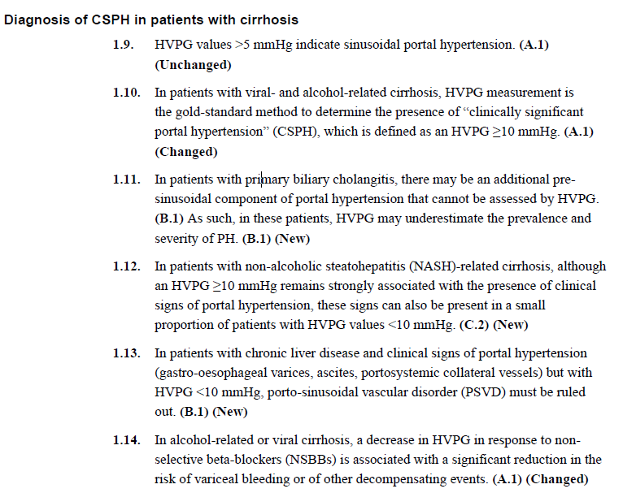
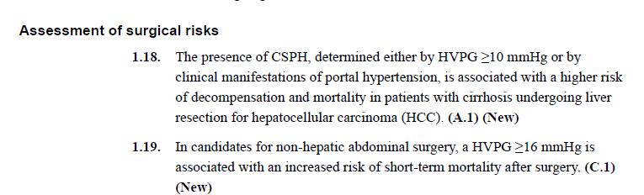

CHIRURGIA BARIATRICA E IPERTENSIONE PORTALE:
BRIDGE PER TRAPIANTO DI FEGATO
Portal Hypertension: definition and clinical significance in MBS
2022
HVPH: hepatic venous pressure gradient
CSPH: clinically significant portal hypertension
de Franchis R, Bosch J, Garcia-Tsao G, Reiberger T, Ripoll C; Baveno VII Faculty. Baveno VII - Renewing consensus in portal hypertension. J Hepatol. 2022 Apr;76(4):959-974.

Slide 12
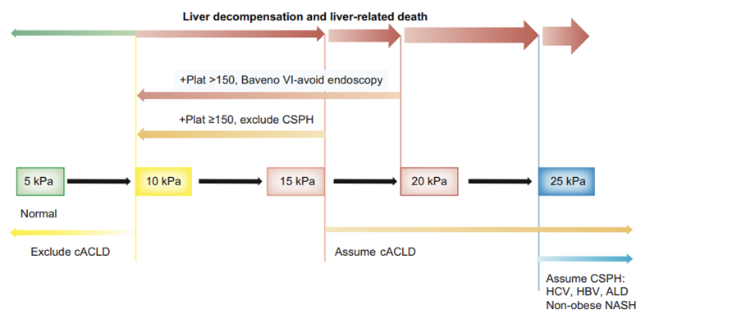
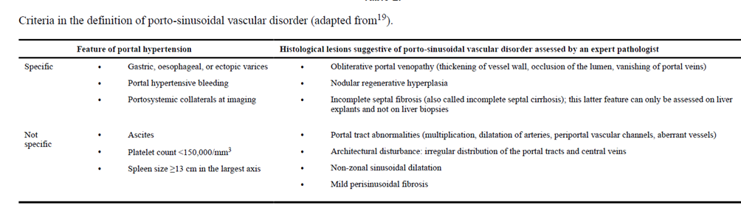
CHIRURGIA BARIATRICA E IPERTENSIONE PORTALE:
BRIDGE PER TRAPIANTO DI FEGATO
Portal Hypertension: definition and clinical significance in MBS
2022
HVPH: hepatic venous pressure gradient
CSPH: clinically significant portal hypertension
cACLD: compensated advanced chronic liver disease
de Franchis R, Bosch J, Garcia-Tsao G, Reiberger T, Ripoll C; Baveno VII Faculty. Baveno VII - Renewing consensus in portal hypertension. J Hepatol. 2022 Apr;76(4):959-974.

Slide 13
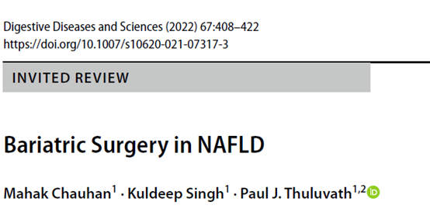
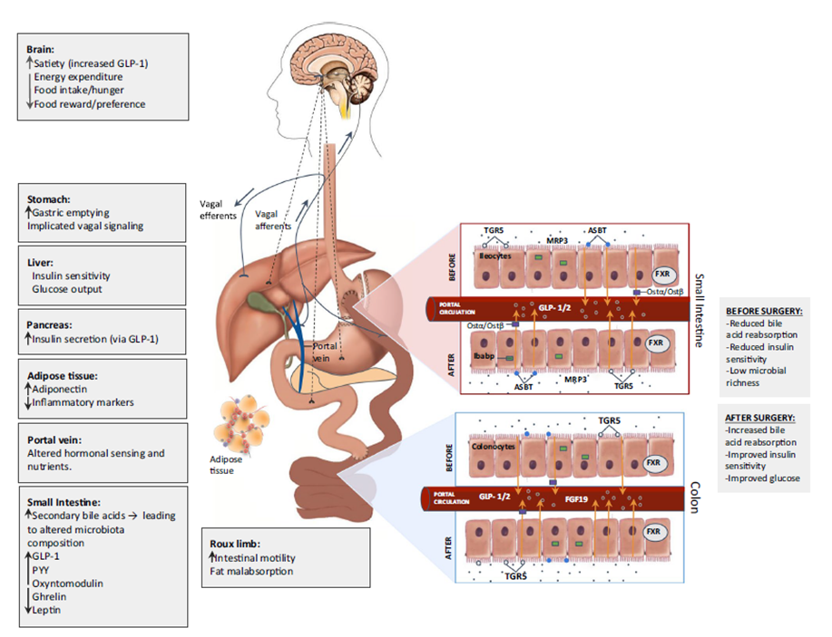
CHIRURGIA BARIATRICA E IPERTENSIONE PORTALE:
BRIDGE PER TRAPIANTO DI FEGATO
Portal Hypertension: definition and clinical significance in MBS
2022
Chauhan M, Singh K, Thuluvath PJ. Bariatric Surgery in NAFLD. Dig Dis Sci. 2022 Feb;67(2):408-422.

Slide 14
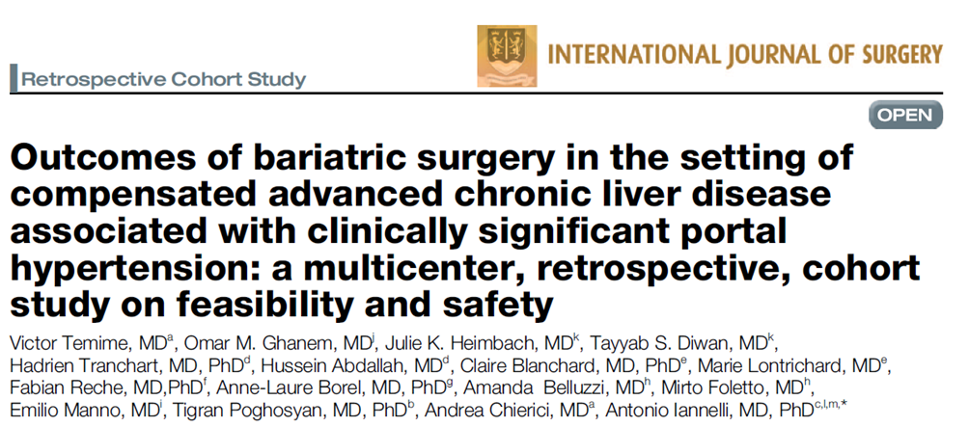
CHIRURGIA BARIATRICA E IPERTENSIONE PORTALE:
BRIDGE PER TRAPIANTO DI FEGATO
Portal Hypertension: definition and clinical significance in MBS
2024
International, multicentric, retrospective study on 63 individuals affected by obesity with compensated advanced chronic liver disease (cACLD) and clinically significant portal hypertension( CSPH) who underwent MBS in tertiary referral centers with experts hepatobiliary surgeons between January 2010 and October 2022.
One patient (1.6%) experienced gastric leakage and mortality. 3 (5%) reported cases of portal vein thrombosis, 2 (3%) postoperative acute renal failure, and 1 (1.6%) postoperative encephalopathy.
Child-Pugh score A resulted to be a protective factor for intraoperative bleeding requiring transfusion at univariate analysis (OR: 0.73, 95% CI: 0.55–0.97, P=0.046) but not at multivariate analysis. MELD>9 score and the type of surgery did not result to be a risk factor for any postoperative complication.
MBS is safe in patients with cALCD and CSPH performed in tertiary bariatric referral centers with hepatobiliary expert surgeons. Larger, prospective studies with longer follow-up periods are needed to confirm these results
Temime V, Ghanem OM, Heimbach JK, Diwan TS, Tranchart H, Abdallah H, Blanchard C, Lontrichard M, Reche F, Borel AL, Belluzzi A, Foletto M, Manno E, Poghosyan T, Chierici A, Iannelli A. Outcomes of bariatric surgery in the setting of compensated advanced chronic liver disease associated with clinically significant portal hypertension: a multicenter, retrospective, cohort study on feasibility and safety. Int J Surg. 2024 Jun 1;110(6):3562-3570.

Slide 15
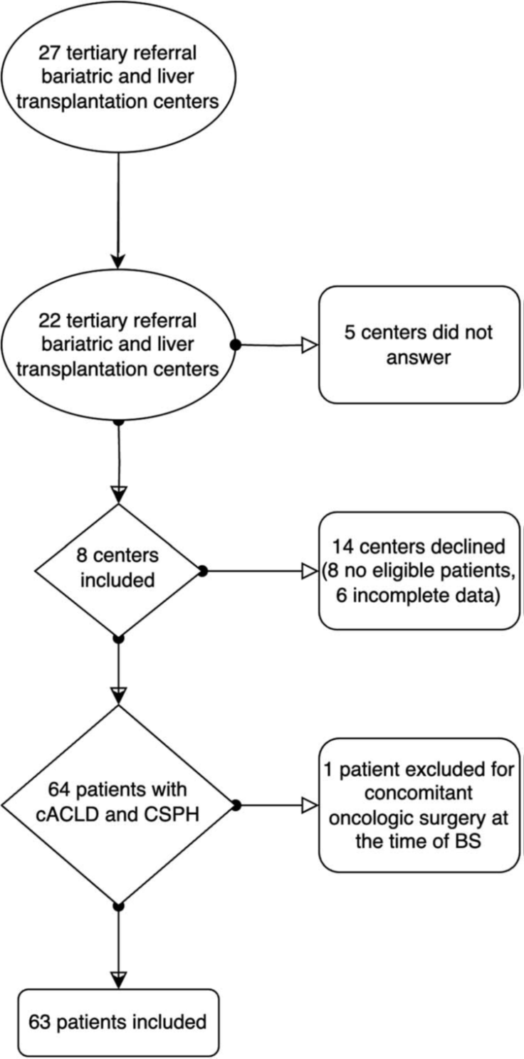
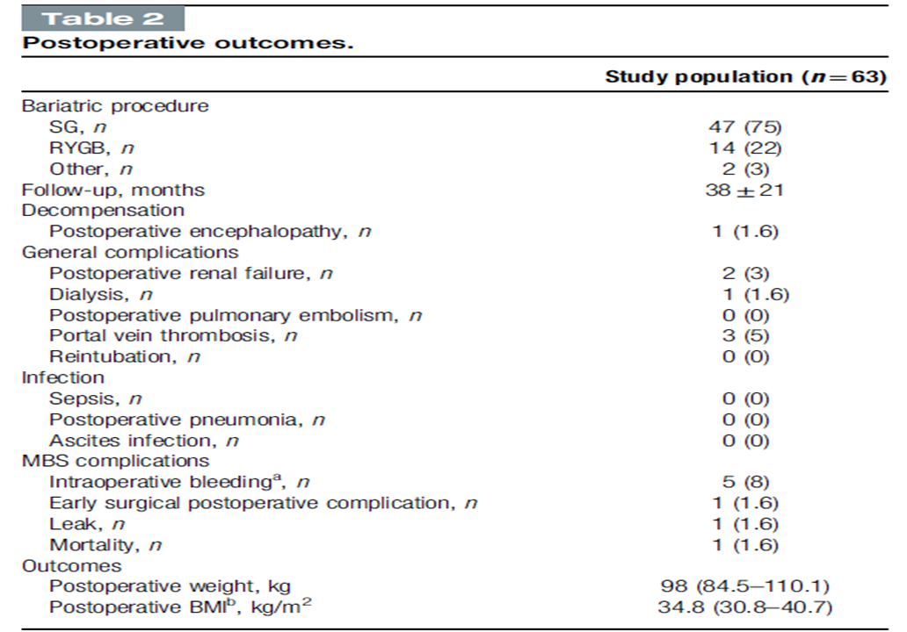
CHIRURGIA BARIATRICA E IPERTENSIONE PORTALE:
BRIDGE PER TRAPIANTO DI FEGATO
Portal Hypertension: definition and clinical significance in MBS
2024
Temime V, Ghanem OM, Heimbach JK, Diwan TS, Tranchart H, Abdallah H, Blanchard C, Lontrichard M, Reche F, Borel AL, Belluzzi A, Foletto M, Manno E, Poghosyan T, Chierici A, Iannelli A. Outcomes of bariatric surgery in the setting of compensated advanced chronic liver disease associated with clinically significant portal hypertension: a multicenter, retrospective, cohort study on feasibility and safety. Int J Surg. 2024 Jun 1;110(6):3562-3570.

Slide 16
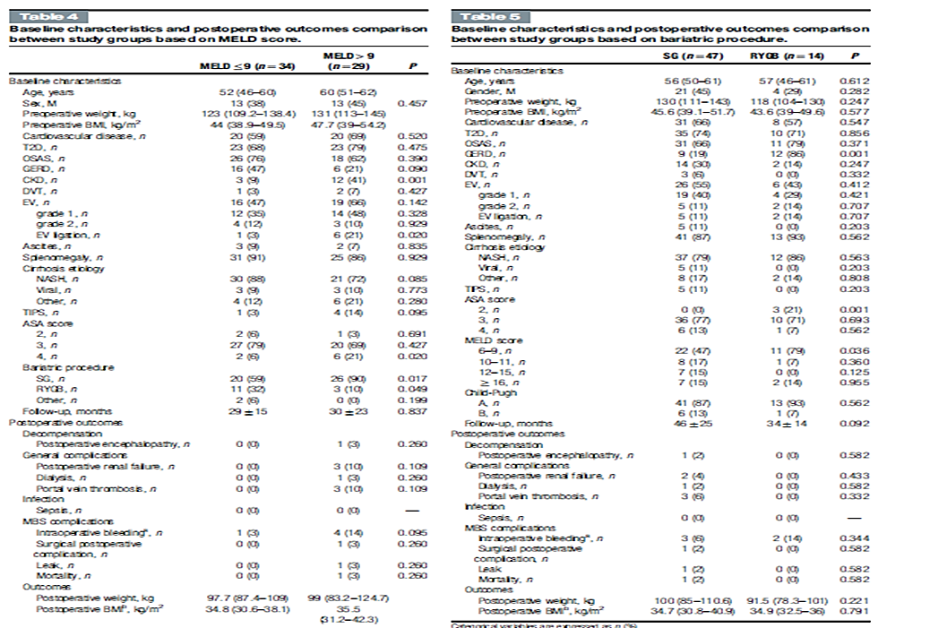
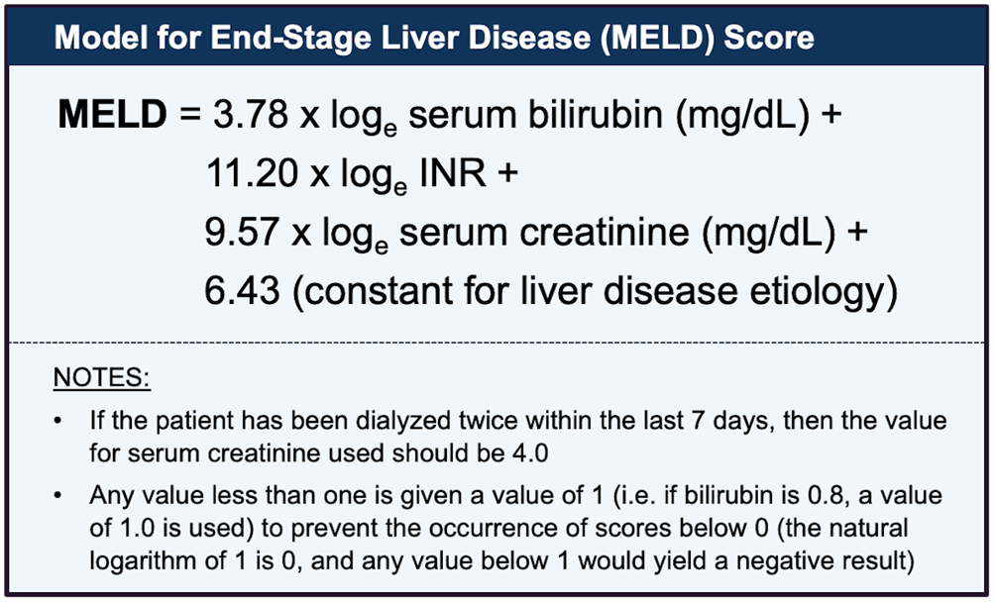
CHIRURGIA BARIATRICA E IPERTENSIONE PORTALE:
BRIDGE PER TRAPIANTO DI FEGATO
Portal Hypertension: definition and clinical significance in MBS
2024
Temime V, Ghanem OM, Heimbach JK, Diwan TS, Tranchart H, Abdallah H, Blanchard C, Lontrichard M, Reche F, Borel AL, Belluzzi A, Foletto M, Manno E, Poghosyan T, Chierici A, Iannelli A. Outcomes of bariatric surgery in the setting of compensated advanced chronic liver disease associated with clinically significant portal hypertension: a multicenter, retrospective, cohort study on feasibility and safety. Int J Surg. 2024 Jun 1;110(6):3562-3570.

Slide 17
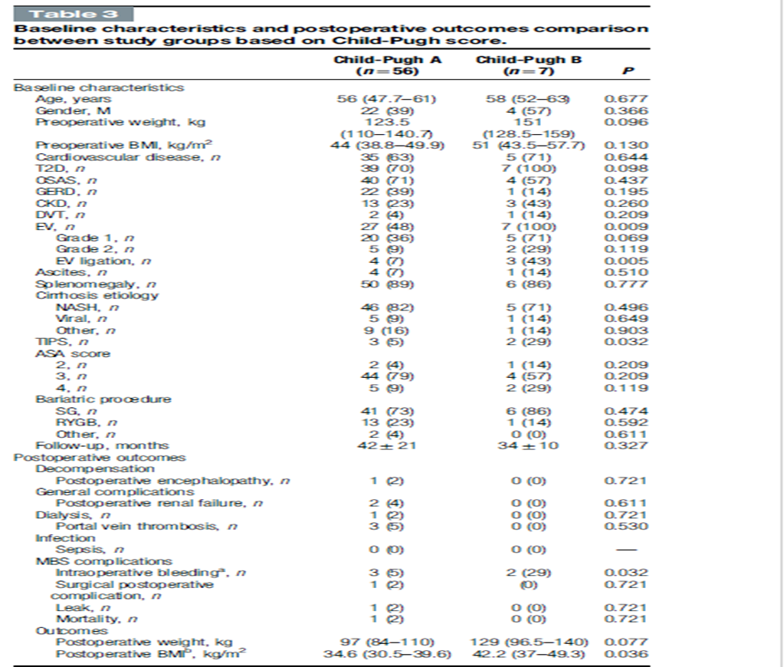
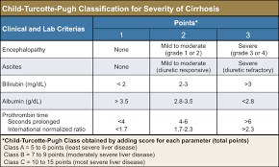
CHIRURGIA BARIATRICA E IPERTENSIONE PORTALE:
BRIDGE PER TRAPIANTO DI FEGATO
Portal Hypertension: definition and clinical significance in MBS
2024
Temime V, Ghanem OM, Heimbach JK, Diwan TS, Tranchart H, Abdallah H, Blanchard C, Lontrichard M, Reche F, Borel AL, Belluzzi A, Foletto M, Manno E, Poghosyan T, Chierici A, Iannelli A. Outcomes of bariatric surgery in the setting of compensated advanced chronic liver disease associated with clinically significant portal hypertension: a multicenter, retrospective, cohort study on feasibility and safety. Int J Surg. 2024 Jun 1;110(6):3562-3570.

Slide 18
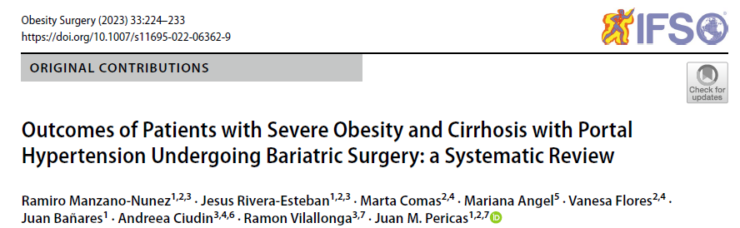
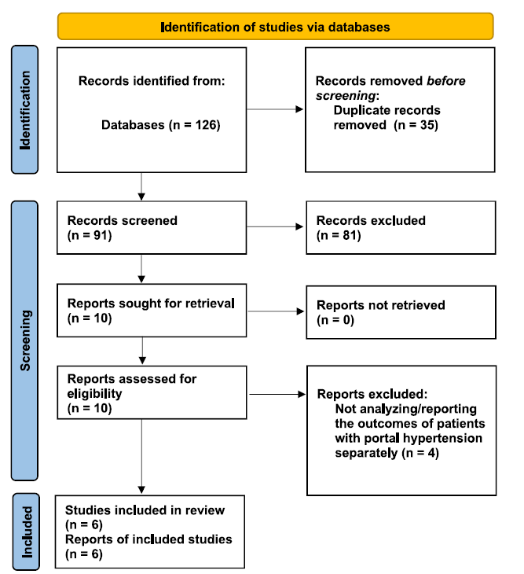
CHIRURGIA BARIATRICA E IPERTENSIONE PORTALE:
BRIDGE PER TRAPIANTO DI FEGATO
Portal Hypertension: definition and clinical significance in MBS
2023
6 articles, including 32 patients, were included.
The most frequent type of BS was sleeve gastrectomy performed in 27 patients.
Perioperative transfusions were often not required. Neither intraoperative nor post-op deaths were reported. All patients reported significant weight loss with improvements in comorbidities during the follow-up periods.
Overall, 27 out of 29 patients had T2DM resolution, and 13 out of 23 had arterial hypertension resolution.
Conclusion This systematic review described the outcomes of BS among patients with SO with cirrhosis and PH. Performing this kind of surgery among these patients appears safe and associated with acceptable perioperative and long-term outcomes. However, further studies are required to provide evidence-based, strong recommendations
Manzano-Nunez R, Rivera-Esteban J, Comas M, Angel M, Flores V, Bañares J, Ciudin A, Vilallonga R, Pericas JM. Outcomes of Patients with Severe Obesity and Cirrhosis with Portal Hypertension Undergoing Bariatric Surgery: a Systematic Review. Obes Surg. 2023 Jan;33(1):224-233.

Slide 19
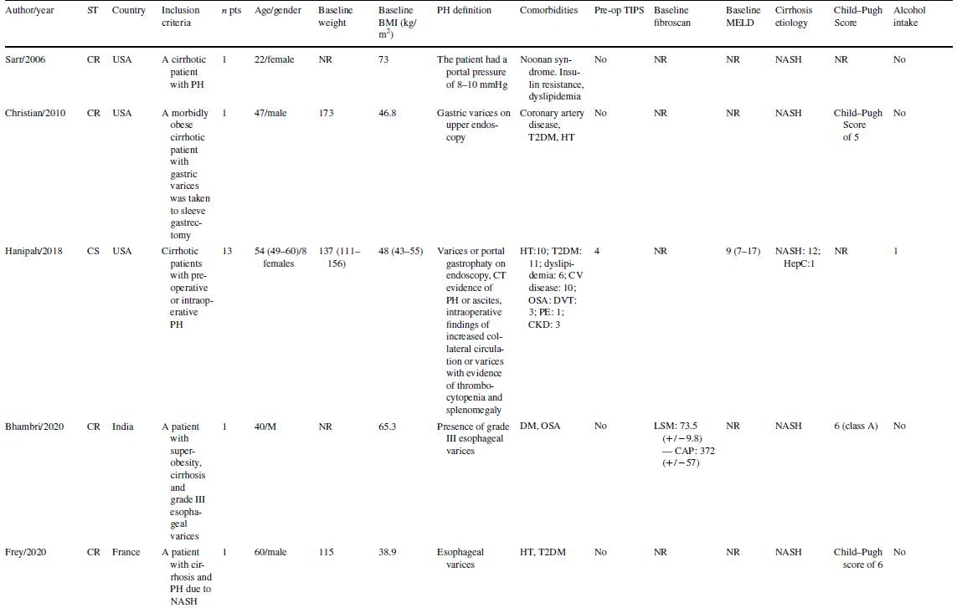
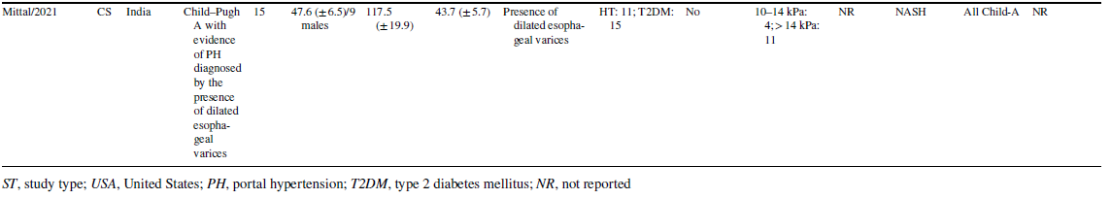
CHIRURGIA BARIATRICA E IPERTENSIONE PORTALE:
BRIDGE PER TRAPIANTO DI FEGATO
Portal Hypertension: definition and clinical significance in MBS
2023
Manzano-Nunez R, Rivera-Esteban J, Comas M, Angel M, Flores V, Bañares J, Ciudin A, Vilallonga R, Pericas JM. Outcomes of Patients with Severe Obesity and Cirrhosis with Portal Hypertension Undergoing Bariatric Surgery: a Systematic Review. Obes Surg. 2023 Jan;33(1):224-233.

Slide 20
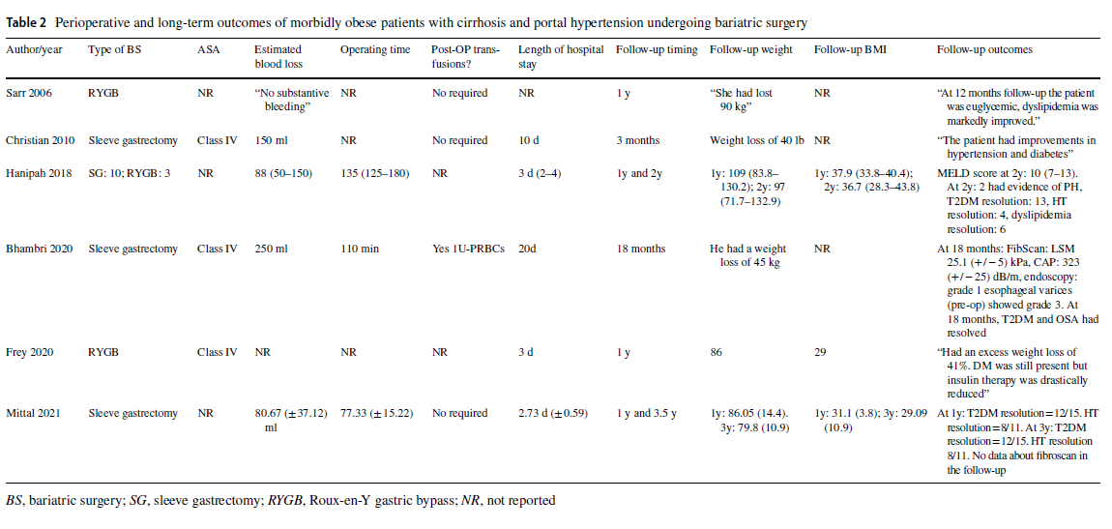
CHIRURGIA BARIATRICA E IPERTENSIONE PORTALE:
BRIDGE PER TRAPIANTO DI FEGATO
Portal Hypertension: definition and clinical significance in MBS
2023
Manzano-Nunez R, Rivera-Esteban J, Comas M, Angel M, Flores V, Bañares J, Ciudin A, Vilallonga R, Pericas JM. Outcomes of Patients with Severe Obesity and Cirrhosis with Portal Hypertension Undergoing Bariatric Surgery: a Systematic Review. Obes Surg. 2023 Jan;33(1):224-233.

Slide 21
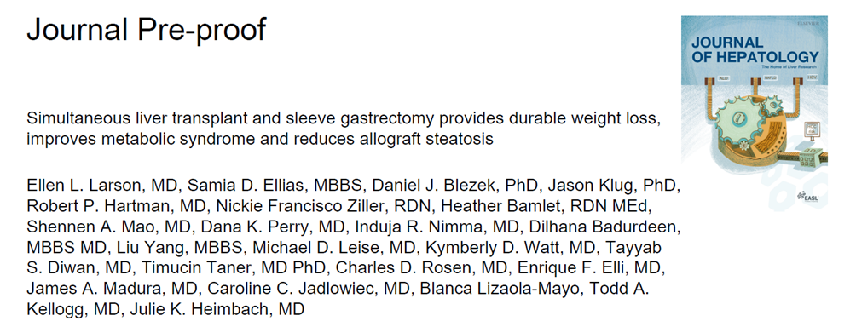
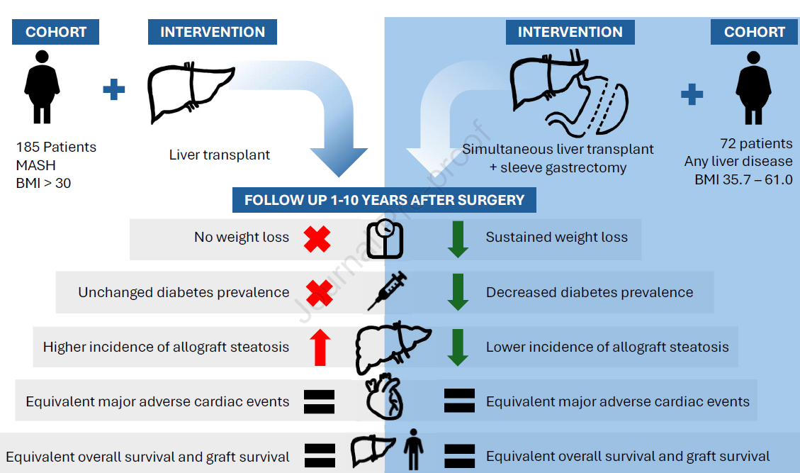
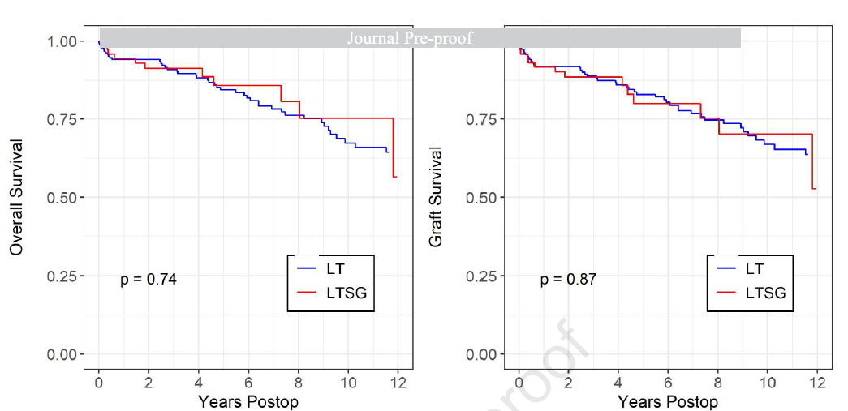
CHIRURGIA BARIATRICA E IPERTENSIONE PORTALE:
BRIDGE PER TRAPIANTO DI FEGATO
MBS and Liver Transplant: where are we now?
2025
Mortality and graft loss were not significantly different between LT and LTSG patients. Post- LTSG patients had significantly lower prevalence of diabetes for >8 years (p<0.05); hypertension decreased from 61.1% to 35.8% (p<0.01).
LTSG patients, with average starting BMI of 45.5, had significant weight loss compared to baseline for >9 years (p<0.001). LT-alone patients, average starting BMI 34.0, experienced no significant change in BMI or diabetes. Development of allograft steatosis was significantly lower in LTSG vs LT patients (p=0.004).
Larson EL et al. Simultaneous liver transplant and sleeve gastrectomy provides durable weight loss, improves metabolic syndrome and reduces allograft steatosis. J Hepatol. 2025 Mar 13:S0168-8278(25)00139-4.

Slide 22
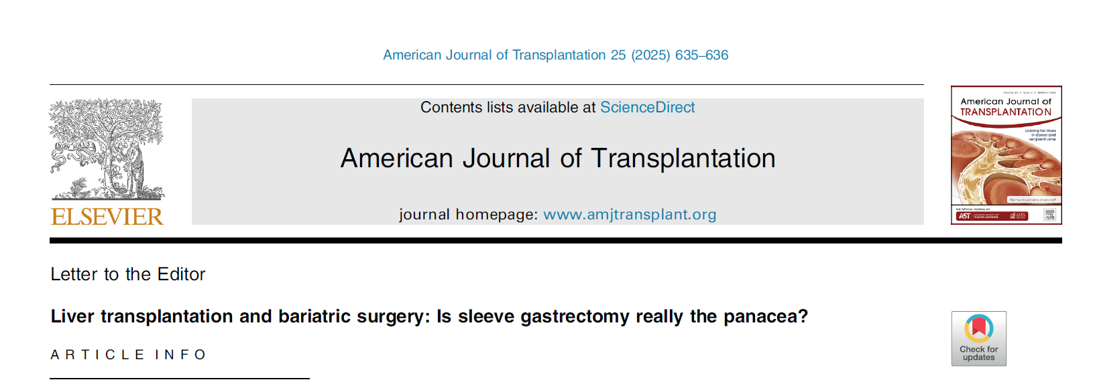
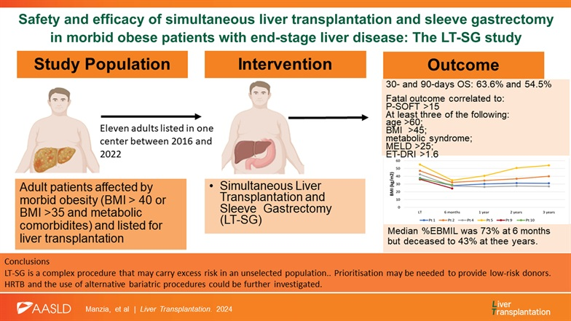
CHIRURGIA BARIATRICA E IPERTENSIONE PORTALE:
BRIDGE PER TRAPIANTO DI FEGATO
MBS and Liver Transplant: where are we now?
2025
The 30- and 90-day overall survival were 63.6% and 54.5%, respectively. All deaths occurred in patients with P-SOFT >15 or in patients who had at least 3 of the following characteristics: >60 years, BMI >45, metabolic syndrome, MELD >25 or eurotransplant donor risk index >1.6.
The 6 months, 1, 2, and 3 years %excess BMI loss was 73%, 60%, 50%, and 43%, respectively.
LT-SG is a complex procedure that may carry excess risk in an unselected population. It should be considered only in highly selected patients. Standard donors are recommended, and prioritization of severely obese patients on the waiting list should be considered.
Sensi B, Manzia TM. Liver transplantation and bariatric surgery: Is sleeve gastrectomy really the panacea? Am J Transplant. 2025 Mar;25(3):635-636.
Manzia TM, Sensi B, Gentileschi P, Quaranta C, Toti L, Baiocchi L, Dauri M, Angelico R, Tisone G. Safety and efficacy of simultaneous liver transplantation and sleeve gastrectomy in morbid obese patients with end-stage liver disease: The LT-SG study. Liver Transpl. 2024 Oct 28.

Slide 23
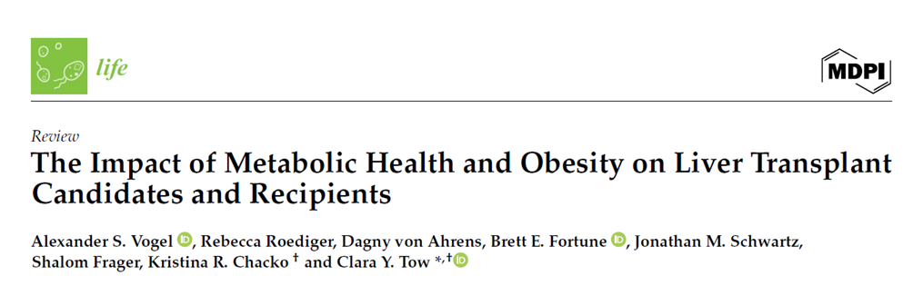
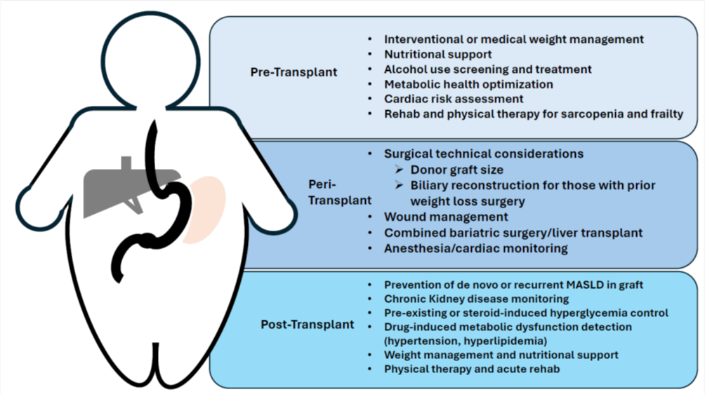
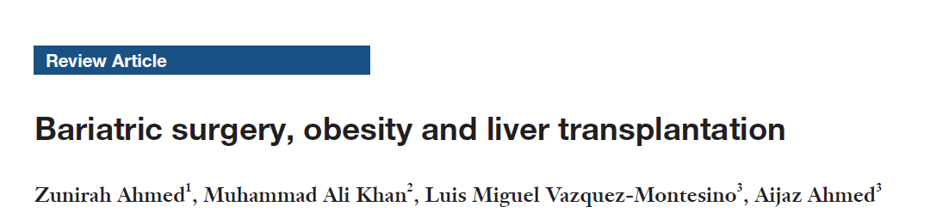
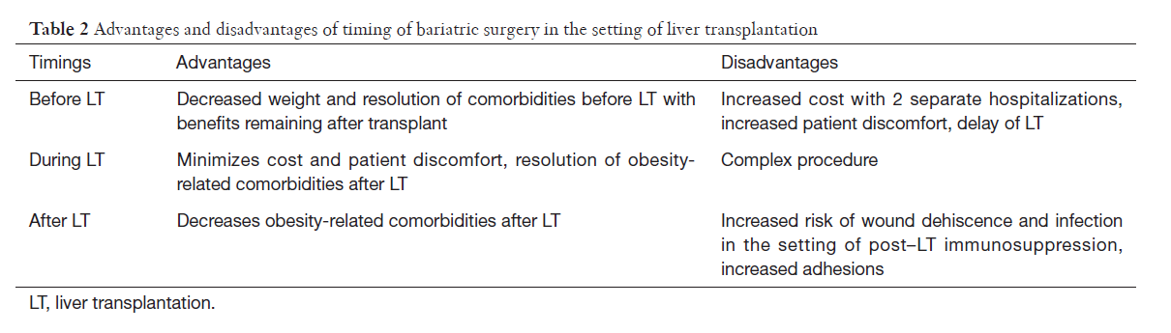
CHIRURGIA BARIATRICA E IPERTENSIONE PORTALE:
BRIDGE PER TRAPIANTO DI FEGATO
MBS and Liver Transplant: where are we now?
2024
2022
Clinical considerations in the patient with obesity or post-bariatric liver transplant patient.
Vogel AS, Roediger R, von Ahrens D, Fortune BE, Schwartz JM, Frager S, Chacko KR, Tow CY. The Impact of Metabolic Health and Obesity on Liver Transplant Candidates and Recipients. Life (Basel). 2024 May 27;14(6):685.
Ahmed Z, Khan MA, Vazquez-Montesino LM, Ahmed A. Bariatric surgery, obesity and liver transplantation. Transl Gastroenterol Hepatol. 2022 Jul 25;7:25.

Slide 24
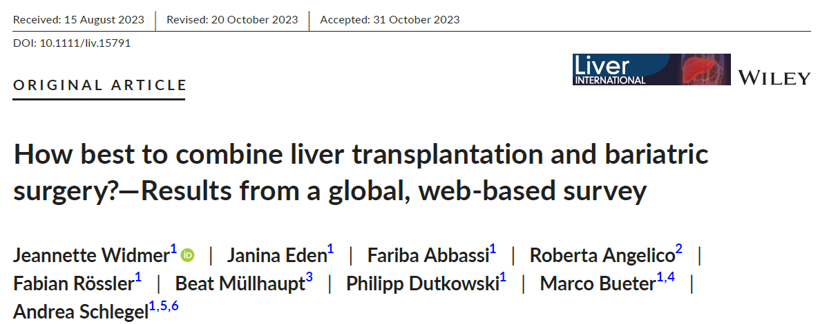
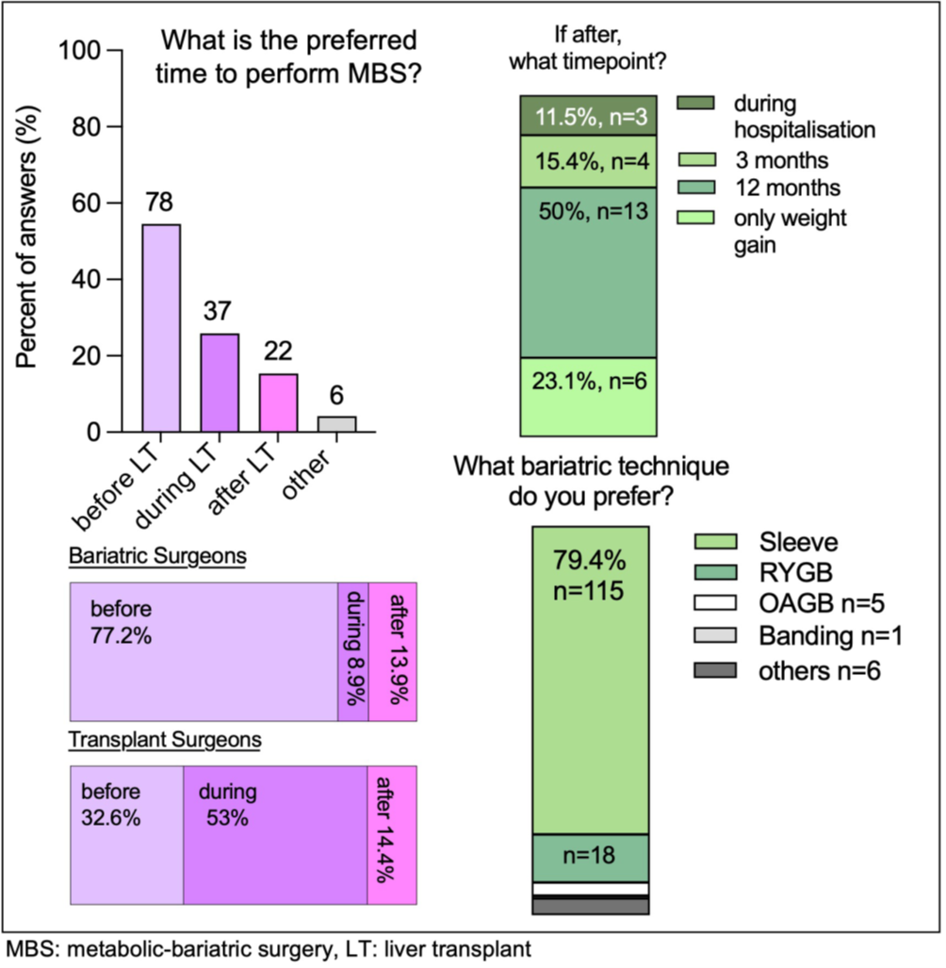
CHIRURGIA BARIATRICA E IPERTENSIONE PORTALE:
BRIDGE PER TRAPIANTO DI FEGATO
MBS and Liver Transplant: where are we now?
2023
Key points
• There is a growing awareness for the need of a multidisciplinary treatment concept for patients with NASH and obesity to guarantee best possible outcome.
• The combination of metabolic-bariatric surgery (MBS) and liver transplantation (LT) is an established approach for one third of respondents of the survey.
• Most bariatric surgeons would prefer MBS ‘before’ LT, while liver transplant surgeons favour a simultaneous approach of the two surgeries.
• The preferred bariatric technique is the sleeve gastrectomy.
Widmer J, Eden J, Abbassi F, Angelico R, Rössler F, Müllhaupt B, Dutkowski P, Bueter M, Schlegel A. How best to combine liver transplantation and bariatric surgery?-Results from a global, web-based survey. Liver Int. 2024 Feb;44(2):566-576.

Slide 25
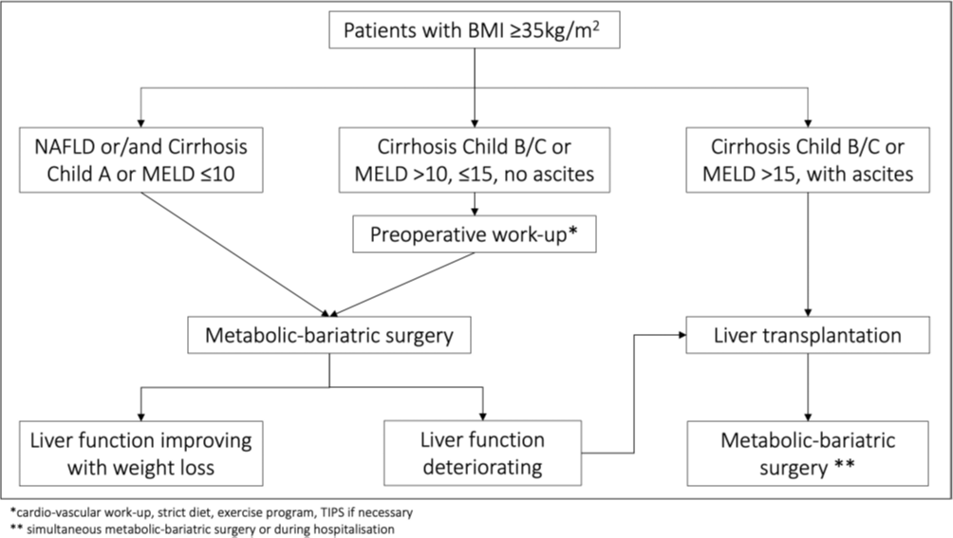
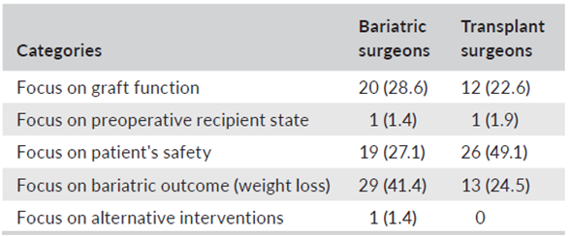
CHIRURGIA BARIATRICA E IPERTENSIONE PORTALE:
BRIDGE PER TRAPIANTO DI FEGATO
MBS and Liver Transplant: where are we now?
2023
Reasons which influences the surgeons to choose
a bariatric technique for liver transplant candidates with NASH.
Widmer J, Eden J, Abbassi F, Angelico R, Rössler F, Müllhaupt B, Dutkowski P, Bueter M, Schlegel A. How best to combine liver transplantation and bariatric surgery?-Results from a global, web-based survey. Liver Int. 2024 Feb;44(2):566-576.

Slide 26
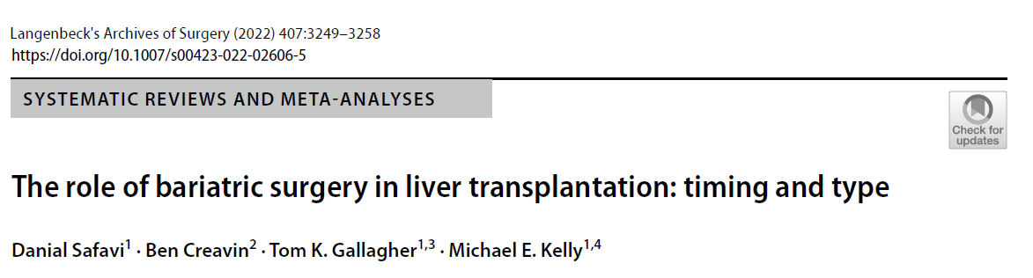

CHIRURGIA BARIATRICA E IPERTENSIONE PORTALE:
BRIDGE PER TRAPIANTO DI FEGATO
MBS and Liver Transplant: where are we now?
2022
Systemic review examining the role of BS in LT patients was performed. From a total of 2374 articles, 5 met the predefined criteria. 162 patients had both BS + LT and 1426 underwent LT alone.
This systematic review was based on the following PICO (Population, Intervention, Comparison, Outcomes) criteria:
• Population: obese patients who are candidates for LT
• Intervention: bariatric surgery before or simultaneous with LT
• Comparators: LT without bariatric surgery
• Outcomes: overall survival, graft survival, post-operative morbidities after LT, length of hospital stay (LOS) after LT, change in BMI, recurrence of steatosis
Safavi, D., Creavin, B., Gallagher, T.K. et al. The role of bariatric surgery in liver transplantation: timing and type. Langenbecks Arch Surg 407, 3249–3258 (2022).

Slide 27

CHIRURGIA BARIATRICA E IPERTENSIONE PORTALE:
BRIDGE PER TRAPIANTO DI FEGATO
MBS and Liver Transplant: where are we now?
2022
Challenges:
Ascites can obscure BMI measurements, with patients having larger volumes of ascites creating an overestimation of their BMI . BMI might not accurately reflect nutritional status.
Most LTs are done on an urgent basis, and many institutions may not have a bariatric surgeon available. Also, the complexity of the operation may not be suitable for all patients and strict criteria should be placed in patient selection
Safavi, D., Creavin, B., Gallagher, T.K. et al. The role of bariatric surgery in liver transplantation: timing and type. Langenbecks Arch Surg 407, 3249–3258 (2022).

Slide 28


CHIRURGIA BARIATRICA E IPERTENSIONE PORTALE:
BRIDGE PER TRAPIANTO DI FEGATO
MBS and Liver Transplant: where are we now?
2021
Lopez-Lopez, V., Ruiz-Manzanera, J.J., Eshmuminov, D. et al. Are We Ready for Bariatric Surgery in a Liver Transplant Program? A Meta-Analysis. OBES SURG 31, 1214–1222 (2021).

Slide 29
CHIRURGIA BARIATRICA E IPERTENSIONE PORTALE:
BRIDGE PER TRAPIANTO DI FEGATO
MBS and Liver Transplant: where are we now?
2021
Meta-analysis of studies included regarding morbidity (a), mortality (b), and hospital stay (c) after bariatric surgery in liver transplant candidates and recipients
In studies where BS was performed prior to LT (n = 2, 28 patients), morbidity rate was 13% (95% CI 0.05–0.31), without heterogeneity (I2 = 0%; p = 0.49) and no reported mortality.
In studies, where BS was performed after LT, morbidity rate was 36% (95% CI 0.23–0.53), without heterogeneity (I2 = 0%; p = 0.76). Only one study reported one fatality of 6 included patients (1/6).
This study highlights that BS can be performed safely in the setting of LT and patients profit from BS with regard to comorbidities related to obesity.
In long-term outcomes after LT, excess BMI has been associated with an increased risk of steatohepatitis and hepatitis C recurrence, or the development of hepatocellular carcinoma along with impaired oncological outcomes.
Lopez-Lopez, V., Ruiz-Manzanera, J.J., Eshmuminov, D. et al. Are We Ready for Bariatric Surgery in a Liver Transplant Program? A Meta-Analysis. OBES SURG 31, 1214–1222 (2021).

Slide 30


CHIRURGIA BARIATRICA E IPERTENSIONE PORTALE:
BRIDGE PER TRAPIANTO DI FEGATO
MBS and Liver Transplant: where are we now?
2021
de Barros, F., Cardoso Faleiro Uba, P. Liver transplantation and bariatric surgery: a new surgical reality: a systematic review of the best time for bariatric surgery. Updates Surg 73, 1615–1622 (2021).

Slide 31





CHIRURGIA BARIATRICA E IPERTENSIONE PORTALE:
BRIDGE PER TRAPIANTO DI FEGATO
MBS and Liver Transplant: where are we now?
2021
de Barros, F., Cardoso Faleiro Uba, P. Liver transplantation and bariatric surgery: a new surgical reality: a systematic review of the best time for bariatric surgery. Updates Surg 73, 1615–1622 (2021).

Slide 32
CHIRURGIA BARIATRICA E IPERTENSIONE PORTALE:
BRIDGE PER TRAPIANTO DI FEGATO
Obesity, organ failure,end-stage liver disease and transplantation
2024
Ghanem OM et al. Obesity, organ failure, and transplantation: a review of the role of metabolic and bariatric surgery in transplant candidates and recipients. Surg Endosc. 2024 Aug;38(8):4138-4151.

Slide 33
TAKE HOME MESSAGES
There is general lack in the literature of research concerning perioperative evaluation and management as well as early and late postoperative outcomes in patients with liver cirrhosis undergoing nonhepatic surgery.
An extensive preoperative work-up to identify the severity of liver disfunction is mandatory since every type of comorbidity, especially renal and cardiopulmonary, should be assessed preoperatively as it can furtherly affect postoperative outcomes.
Preoperative risk stratification leads to a more precise prediction of outcomes as Child-Pugh score A and MELD <10 seem to be associated with a minimal increase in postoperative mortality compared to patients with more severe liver conditions
Implementation of clinical programs and research endeavors on MBS for individuals with obesity and cirrhosis with PH should be done by multidisciplinary teams and in hospitals with bariatric surgery and transplantation programs with both center and surgeon specific high procedure volume

Slide 34

Grazie

